Slide 1
CS 35L Software Construction Lab Week 4 – Debugging

Slide 2
Debugging Process
Reproduce the bug
Simplify program input
Use a debugger to track down the origin of the problem
Fix the problem

Slide 3
Debugger
A program that is used to run and debug other (target) programs
Advantages:
Programmer can:
step through source code line by line
each line is executed on demand
interact with and inspect program at run-time
If program crashes, the debugger outputs where and why it crashed

Slide 4
GDB – GNU Debugger
Debugger for several languages
C, C++, Java, Objective-C… more
Allows you to inspect what the program is doing at a certain point during execution
Logical errors and segmentation faults are easier to ﬁnd with the help of gdb

Slide 5
Using GDB
Compile Program
Normally: $ gcc [flags] <source files> -o <output file>
Debugging: $ gcc [other flags] –g <source files> -o <output file>
enables built-in debugging support
Specify Program to Debug
$ gdb <executable>
or
$ gdb
(gdb) file <executable>

Slide 6
Run-Time Errors
Segmentation fault
Program received signal SIGSEGV, Segmentation fault. 0x0000000000400524 in function (arr=0x7fffc902a270, r1=2, c1=5, r2=4, c2=6) at file.c:12
Line number where it crashed and parameters to the function that caused the error
Logic Error
Program will run and exit successfully
How do we find bugs?

Slide 7
Using GDB
3. Run Program
(gdb) run or
(gdb) run [arguments]
4. In GDB Interactive Shell
Tab to Autocomplete, up-down arrows to recall history
help [command] to get more info about a command
5. Exit the gdb Debugger
(gdb) quit

Slide 8
Walk-through
#include <stdlib.h>
#include <stdio.h>
int add(int a, int b) {
return a+b;
}
void main() {
int a=5,b=10,c;
c=add(a,b);
printf("Value of c is %d\n", c);
int *ptr =NULL;
printf("Ptr points to %d",*ptr);
c=19;
printf("New c=%d",c);
}

Slide 9
NULL vs void pointer
A null pointer is a value. A special reserved value used to indicate that the pointer is not pointing to anything conceptually.
A void pointer is a type of pointer, void*. It is used to indicate that the storage location pointed to by the pointer has no specific type.

Slide 10
Setting Breakpoints
Breakpoints
used to stop the running program at a specific point
If the program reaches that location when running, it will pause and prompt you for another command
Example:
(gdb) break file1.c:6
Program will pause when it reaches line 6 of file1.c
(gdb) break my_function
Program will pause at the first line of my_function every time it is called
(gdb) break [position] if expression
Program will pause at specified position only when the expression evaluates to true

Slide 11
Breakpoints
Setting a breakpoint and running the program will stop program where you tell it to
You can set as many breakpoints as you want
(gdb) info breakpoints|break|br|b shows a list of all breakpoints

Slide 12
Basic commands
(gdb)step - Step to next line of code. Will step into a function.
(gdb)next - Execute next line of code. Will not enter functions.
(gdb)print <var> - Print value stored in variable.
(gdb)continue - Continue execution to next break point.
(gdb)set var <name>=<value> - Executes rest of program with new value of variable.
(gbd) b <line number> - to apply breakpoint

Slide 13
Deleting, Disabling and Ignoring BPs
(gdb) delete [bp_number | range]
Deletes the specified breakpoint or range of breakpoints
(gdb) disable [ bp_number | range]
Temporarily deactivates a breakpoint or a range of breakpoints
(gdb) enable [ bp_number | range]
Restores disabled breakpoints
If no arguments are provided to the above commands, all breakpoints are affected!!
(gdb) ignore bp_number iterations
Instructs GDB to pass over a breakpoint without stopping a certain number of times.
bp_number: the number of a breakpoint
Iterations: the number of times you want it to be passed over

Slide 14
Displaying Data
Why would we want to interrupt execution?
to see data of interest at run-time:
(gdb) print [/format] expression
Prints the value of the specified expression in the specified format
Formats:
d: Decimal notation (default format for integers)
x: Hexadecimal notation
o: Octal notation
t: Binary notation

Slide 15
Resuming Execution After a Break
When a program stops at a breakpoint
4 possible kinds of gdb operations:
c or continue: debugger will continue executing until next breakpoint
s or step: debugger will continue to next source line
n or next: debugger will continue to next source line in the current (innermost) stack frame
f or finish: debugger will resume execution until the current function returns. Execution stops immediately after the program flow returns to the function's caller
the function's return value and the line containing the next statement are displayed

Slide 16
Watchpoints
Watch/observe changes to variables
(gdb) watch my_var
sets a watchpoint on my_var
the debugger will stop the program when the value of my_var changes
old and new values will be printed
(gdb) rwatch expression
The debugger stops the program whenever the program reads the value of any object involved in the evaluation of expression

Slide 17
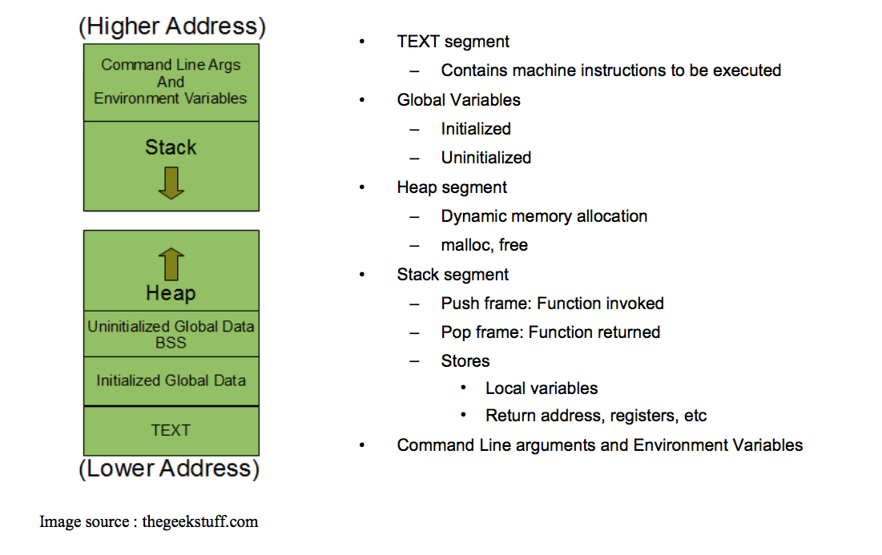
Process Memory Layout

Slide 18
Stack Info
A program is made up of one or more functions which interact by calling each other
Every time a function is called, an area of memory is set aside for it. This area of memory is called a stack frame and holds the following crucial info:
storage space for all the local variables
the memory address to return to when the called function returns
the arguments, or parameters, of the called function
Each function call gets its own stack frame. Collectively, all the stack frames make up the call stack

Slide 19
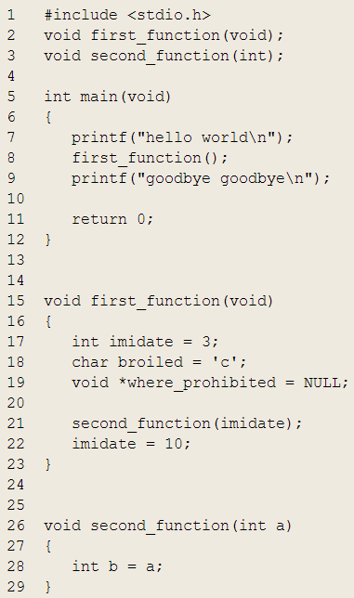
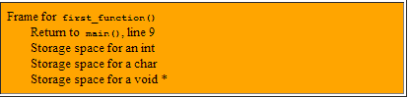

Stack Frames and the Stack
Program Ends

Slide 20
Analyzing the Stack in GDB
(gdb) backtrace|bt
Shows the call trace (the call stack)
Without function calls:
#0 main () at program.c:10
one frame on the stack, numbered 0, and it belongs to main()
After call to function display()
#0 display (z=5, zptr=0xbffffb34) at program.c:15
#1 0x08048455 in main () at program.c:10
Two stack frames: frame 1 belonging to main() and frame 0 belonging to display().
Each frame listing gives
the arguments to that function
the line number that's currently being executed within that frame

Slide 21
Analyzing the Stack
(gdb) info frame
Displays information about the current stack frame, including its return address and saved register values
(gdb) info locals
Lists the local variables of the function corresponding to the stack frame, with their current values
(gdb) info args
List the argument values of the corresponding function call

Slide 22
Other Useful Commands
(gdb) info functions
Lists all functions in the program
(gdb) list
Lists source code lines around the current line

Slide 23
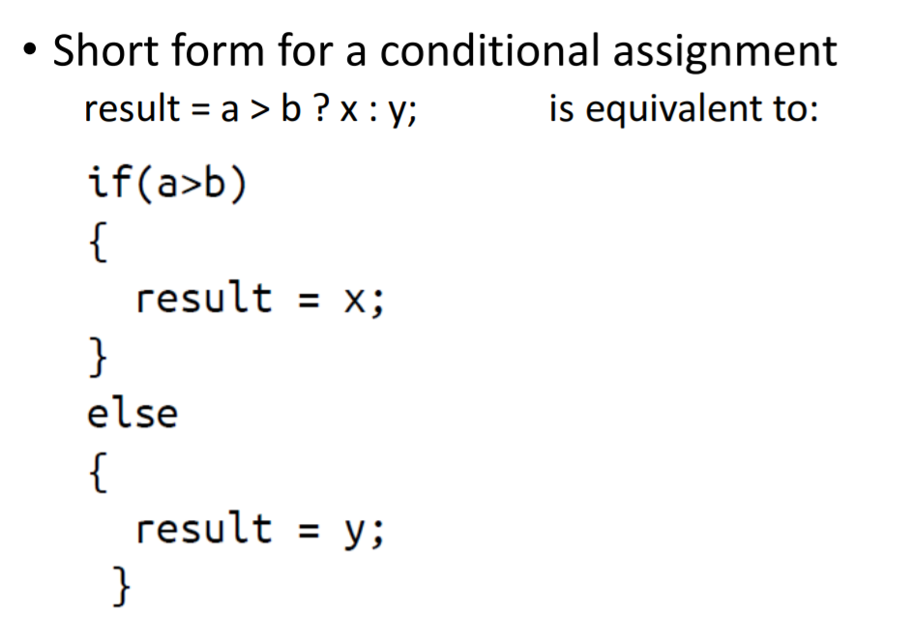
Ternary Operator

Slide 24
Task 1
Program Statement – Define a structure called player that will describe the following information.
name (char *array)
team (char * array)
batting average (double)
Then create an array (of size 5) of this structure type.
struct player players[5]; //access attributes using players[index].attributename}
Using player, declare an array player with 5 elements and write a program to read the information about all the 5 players and print a sorted team wise list (sort by team name) containing names of players with their batting average.
*you can hardcode the data for your convenience
Use the qsort function
Notes:
http://www.c4learn.com/c-programs/sorting-elements-of-structure.html

Slide 25
Task 1 solution
int compare (const void * a, const void * b ) {
struct player *pa = (struct player *)a;
struct player *pb = (struct player *)b;
return strcmp(pa->teamname,pb->teamname);
}
qsort(players,5, sizeof(struct player),compare);
*you can also typedef to avoid writing ‘struct’
Notes:
http://www.c4learn.com/c-programs/sorting-elements-of-structure.html
https://ideone.com/II4BFb

Slide 26
Segfault code – debug it!
#include<stdio.h>
#include<stdlib.h>
int main(int argc, char **argv){
char *buf;
buf=malloc(1<<31);
fgets(buf, 1024, stdin);
printf("%s\n", buf);
return 1;
}
Some other examples: https://www.geeksforgeeks.org/core-dump-segmentation-fault-c-cpp/
Notes:
Well, the value of the expression 1 << 31 (the integer 1 right-shifted 31 times) is 429497295, or 4GB (gigabytes). Very few machines have this kind of memory - mine only has 256MB. So of cousre malloc would fail. Furthermore, we are only reading in 1024 bytes in the fgets call. All that extra space would be wasted, even if we could allocate it. Change the 1<<31 to 1024 (or 1<<9), and the program will work as expected:

Slide 27
Initializing array using malloc
int *arr = malloc (sizeof (int) * n); /* n is the length of the array */
int i;
for (i=0; i<n; i++)
{
arr[i] = 0;
}

Slide 28
Task 2
/*Using structures to calculate the area of a rectangle*/
Create two structs for Rectangle and Point.
Calculate the area of the rectangle using the given coordinates (top left and bottom right)

Slide 29
Task 2 Solution
#include <stdio.h>
#include <string.h>
#include <math.h>
typedef struct {
double x;
double y;
} Point;
typedef struct {
Point topLeft; /* top left point of rectangle */
Point botRight; /* bottom right
point of rectangle */
} Rectangle;
double computeArea(Rectangle *r);
int main()
{
Point p;
Rectangle r;
printf("\nEnter top left point: ");
scanf("%lf", &r.topLeft.x);
scanf("%lf", &r.topLeft.y);
printf("Enter bottom right point: ");
scanf("%lf", &r.botRight.x);
scanf("%lf", &r.botRight.y);
printf("Top left x = %lf y = %lf\n", r.topLeft.x, r.topLeft.y);
printf("Bottom right x = %lf y = %lf\n", r.botRight.x, r.botRight.y);
printf("Area = %f", computeArea(&r));
return 0;
}
double computeArea(Rectangle *r)
{
double height, width, area;
height = ((r->topLeft.y) - (r->botRight.y));
width = (-(r->topLeft.x) + (r->botRight.x));
area = height*width;
return (area);
}

Slide 30
Task 3
Write a C program using getchar() and putchar() which continuously takes user input and prints it on the screen. This should keep on happening till the user inputs a string containing ‘#’ and Enters.
Hint: use while(getchar() != ‘#’)

Slide 31
Task 3 solution
#include <stdio.h>
/* -- Copy input to output -- */
int main(void)
{
char c;
c = getchar();
while ( c != "#" ) {
putchar(c);
c = getchar();
}
return 0;
}

Slide 32
Task 4
Write the following line in a file called file.txt
The value stored is 100
Use fscanf to read the value 100 from file.txt and store it in a variable <var>.
Then write this value to another file file1.txt “Value read is <var>” using fprintf
fscanf(fp, "This is the value %d", &a);
fprintf(fp1, "Value read is %d",a);

Slide 33
Task 4 solution
#include <stdio.h>
#include <stdlib.h>
int main() {
int a;
FILE * fp;
FILE * fp1;
fp = fopen("file.txt","r+");
fp1 = fopen("file1.txt", "w+");
fscanf(fp, "This is the value %d", &a);
fprintf(fp1, "Value read is %d",a);
fclose(fp);
return 0;
}

Slide 34
Gdb pointers
Gdb cheat sheet
Gdb command tutorial and slides
Running gdb with emacs

Slide 35
Lab 4
Download old version of coreutils with buggy ls program
Untar, configure, make
Bug: ls -t mishandles files whose time stamps are very far in the past. It seems to act as if they are in the future
$ tmp=$(mktemp -d)
$ cd $tmp
$ touch -d ‘1918-11-11 11:00 GMT’ wwi-armistice
$ touch now
$ sleep 1
$ touch now1
$ ls -lt –full-time wwi-armistice now now1
Output:
-rw-r--r-- 1 eggert csfac 0 2018-10-29 16:43:16.805404419 +0000 now1
-rw-r--r-- 1 eggert csfac 0 2018-10-29 16:43:15.801376773 +0000 now
-rw-r--r-- 1 eggert csfac 0 1918-11-11 11:00:00.000000000 +0000 wwi-armistice

Slide 36
Steps
Wget the coreutils
Untar
Configure --prefix
Make
Throws error
Get the patch (wget)
Edit the patch (just delete ~ from your coreutils patch file)
Apply the patch [use p0] (you must have figured it out that 5 files have been patched)
Build it
Reproduce the bug
Find the bug using gdb (for bin/ls in the dir you created ) and fix it (info functions and info locals)
Produce the patch
Test it

Slide 37
Goal: Fix the Bug
Reproduce the Bug
Follow steps on lab web page
Simplify input
Run ls with –l and –t options only
Debug
Use gdb to figure out what’s wrong
$ gdb ./ls
(gdb) run –lt wwi-armistice now now1
(run from the directory where the compiled ls lives)
Patch
Construct a patch “lab4.diff” containing your fix
It should contain a ChangeLog entry followed by the output of diff -u

Slide 38
Lab Hints
Use “info functions” to look for relevant starting point
Use “info locals” to check values of local variables
Compiler optimizations: -O2 -> -O0
./configure CFLAGS="…-O0"

Slide 39
Homework 4
Write a C program called sfrob
Reads stdin byte-by-byte (getchar)
Consists of records that are newline-delimited
Each byte is frobnicated (XOR with dec 42)
Sort records without decoding (qsort, frobcmp)
Output result in frobnicated encoding to stdout (putchar)
Dynamic memory allocation (malloc, realloc, free)

Slide 40
Example
Input: printf 'sybjre obl’
$ printf 'sybjre obl\n' | ./sfrob
Read the records: sybjre, obl
Compare records using frobcmp function
Use frobcmp as compare function in qsort
Output: obl
sybjre

Slide 41
Homework Hints
Array of pointers to char arrays to store strings (char ** arr)
Use the right cast while passing frobcmp to qsort
cast from void * to char ** and then dereference because frobcmp takes a char *
Use realloc to reallocate memory for every string and the array of strings itself, dynamically
Use exit, not return when exiting with error

